Slide 1
Mental Health in Tech Industry
Noor Ahmed (2112282)
Keertan Kumar (2012161)

Slide 2
Introduction
Mental health encompasses a wide range of psychological, emotional, and social aspects.
These days, it leaves a lasting influence on both the prosperity of a company and the well-being of its employees.
In job culture a person’s mental health matters a lot. In fact, having a good mental health positively affects job performance.

Slide 3
Problem Statement
This project aims to gain insights and look at factors that contribute to mental health problems in the tech industry. This objective is possible to achieve by using a mental health dataset provided by OSMI (Open Sourcing Mental Illness). The dataset is utilized by using machine learning techniques to predict the treatment needed for an employee using various features of the dataset. An interactive Power BI dashboard has also been the goal of this project to further interact with the data.

Slide 4
Methodology
Data Cleaning
Data Visualization
Model Training
Power BI Dashboard

Slide 5
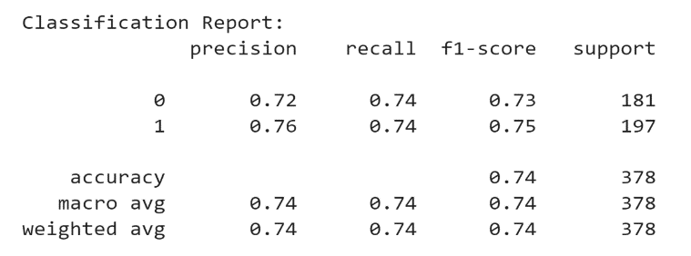
Model Training
Decision Tree Performance

Slide 6
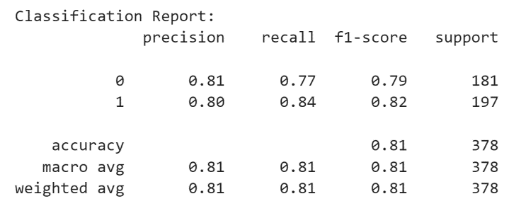
Model Training
Random Forest Performance

Slide 7
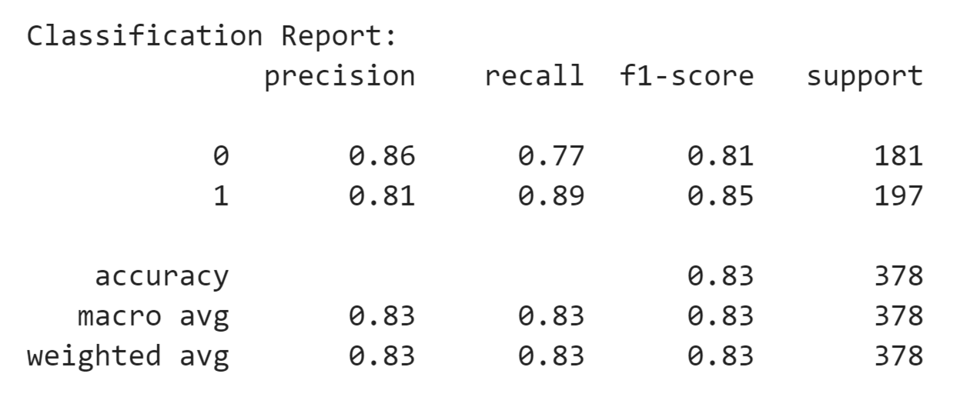
Model Training
Gradient Boost Performance

Slide 8
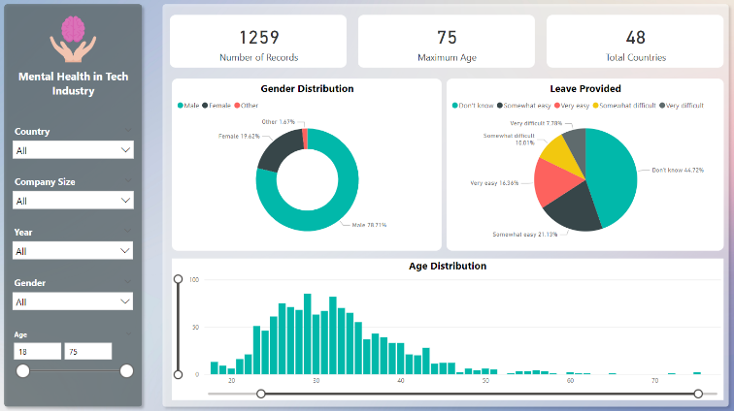
Power BI Dashboard

Slide 9
Conclusion
Mental health is an important issue in the tech industry, and while awareness of mental health is increasing, the impact of these efforts may be limited as there is still a need to further support and provide resources, especially in the tech industry where employees face many challenges like long working hours, high pressure and layoffs. To address issues like these, it is necessary for tech industry companies to prioritize mental health issues and provide a supportive working environment. An employee’s performance in their workplace and well-being are closely tied to their mental health. OSMI (Open Sourcing Mental Health), a non-profit organization provides help in the tech industry to improve mental wellness. By utilizing their dataset in this project, we found that more awareness should be made to address these issues and provide assistance to employees who are facing many challenges due to bad mental health.

Slide 10
References
[1] “Relationship between Employee Mental Health and Job Performance: Mediation Role of Innovative Behavior and Work Engagement - PMC.” Accessed: Dec. 24, 2023. [Online]. Available: https://www.ncbi.nlm.nih.gov/pmc/articles/PMC9180763/
[2] M. T. Ford, C. P. Cerasoli, J. A. Higgins, and A. L. Decesare, “Relationships between psychological, physical, and behavioural health and work performance: A review and meta-analysis,” Work & Stress, vol. 25, no. 3, pp. 185–204, Jul. 2011, doi: 10.1080/02678373.2011.609035.
[3] K. Memish, A. Martin, L. Bartlett, S. Dawkins, and K. Sanderson, “Workplace mental health: An international review of guidelines,” Preventive Medicine, vol. 101, pp. 213–222, Aug. 2017, doi: 10.1016/j.ypmed.2017.03.017.
[4] A. B. R. Shatte, D. M. Hutchinson, and S. J. Teague, “Machine learning in mental health: a scoping review of methods and applications,” Psychological Medicine, vol. 49, no. 9, pp. 1426–1448, Jul. 2019, doi: 10.1017/S0033291719000151.
[5] R. Katarya and S. Maan, “Predicting Mental health disorders using Machine Learning for employees in technical and non-technical companies,” in 2020 IEEE International Conference on Advances and Developments in Electrical and Electronics Engineering (ICADEE), Dec. 2020, pp. 1–5. doi: 10.1109/ICADEE51157.2020.9368923.

Slide 11
Thank You

